Slide 1
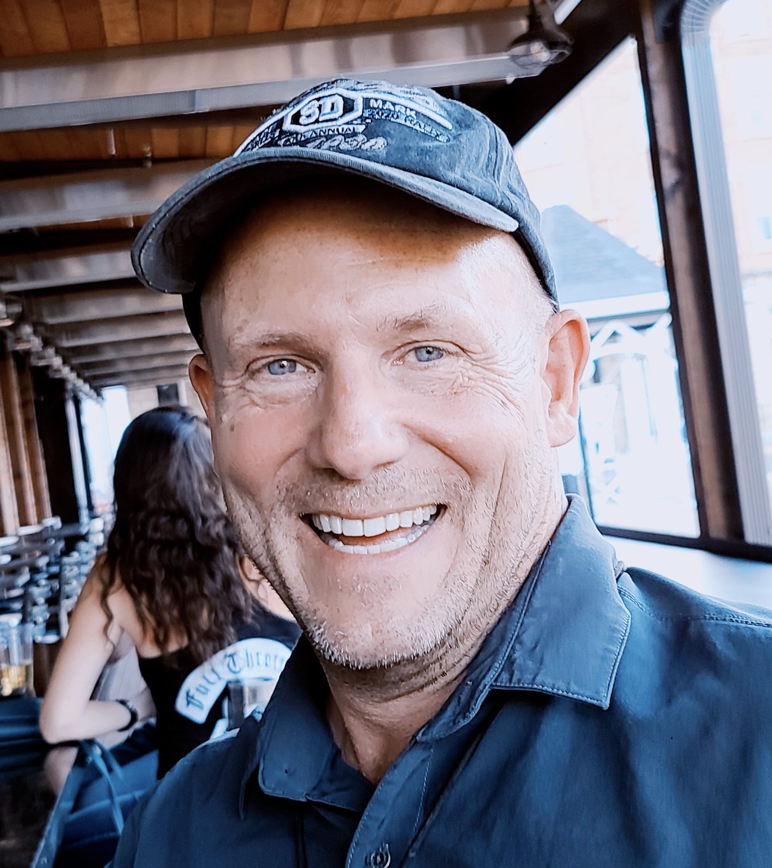
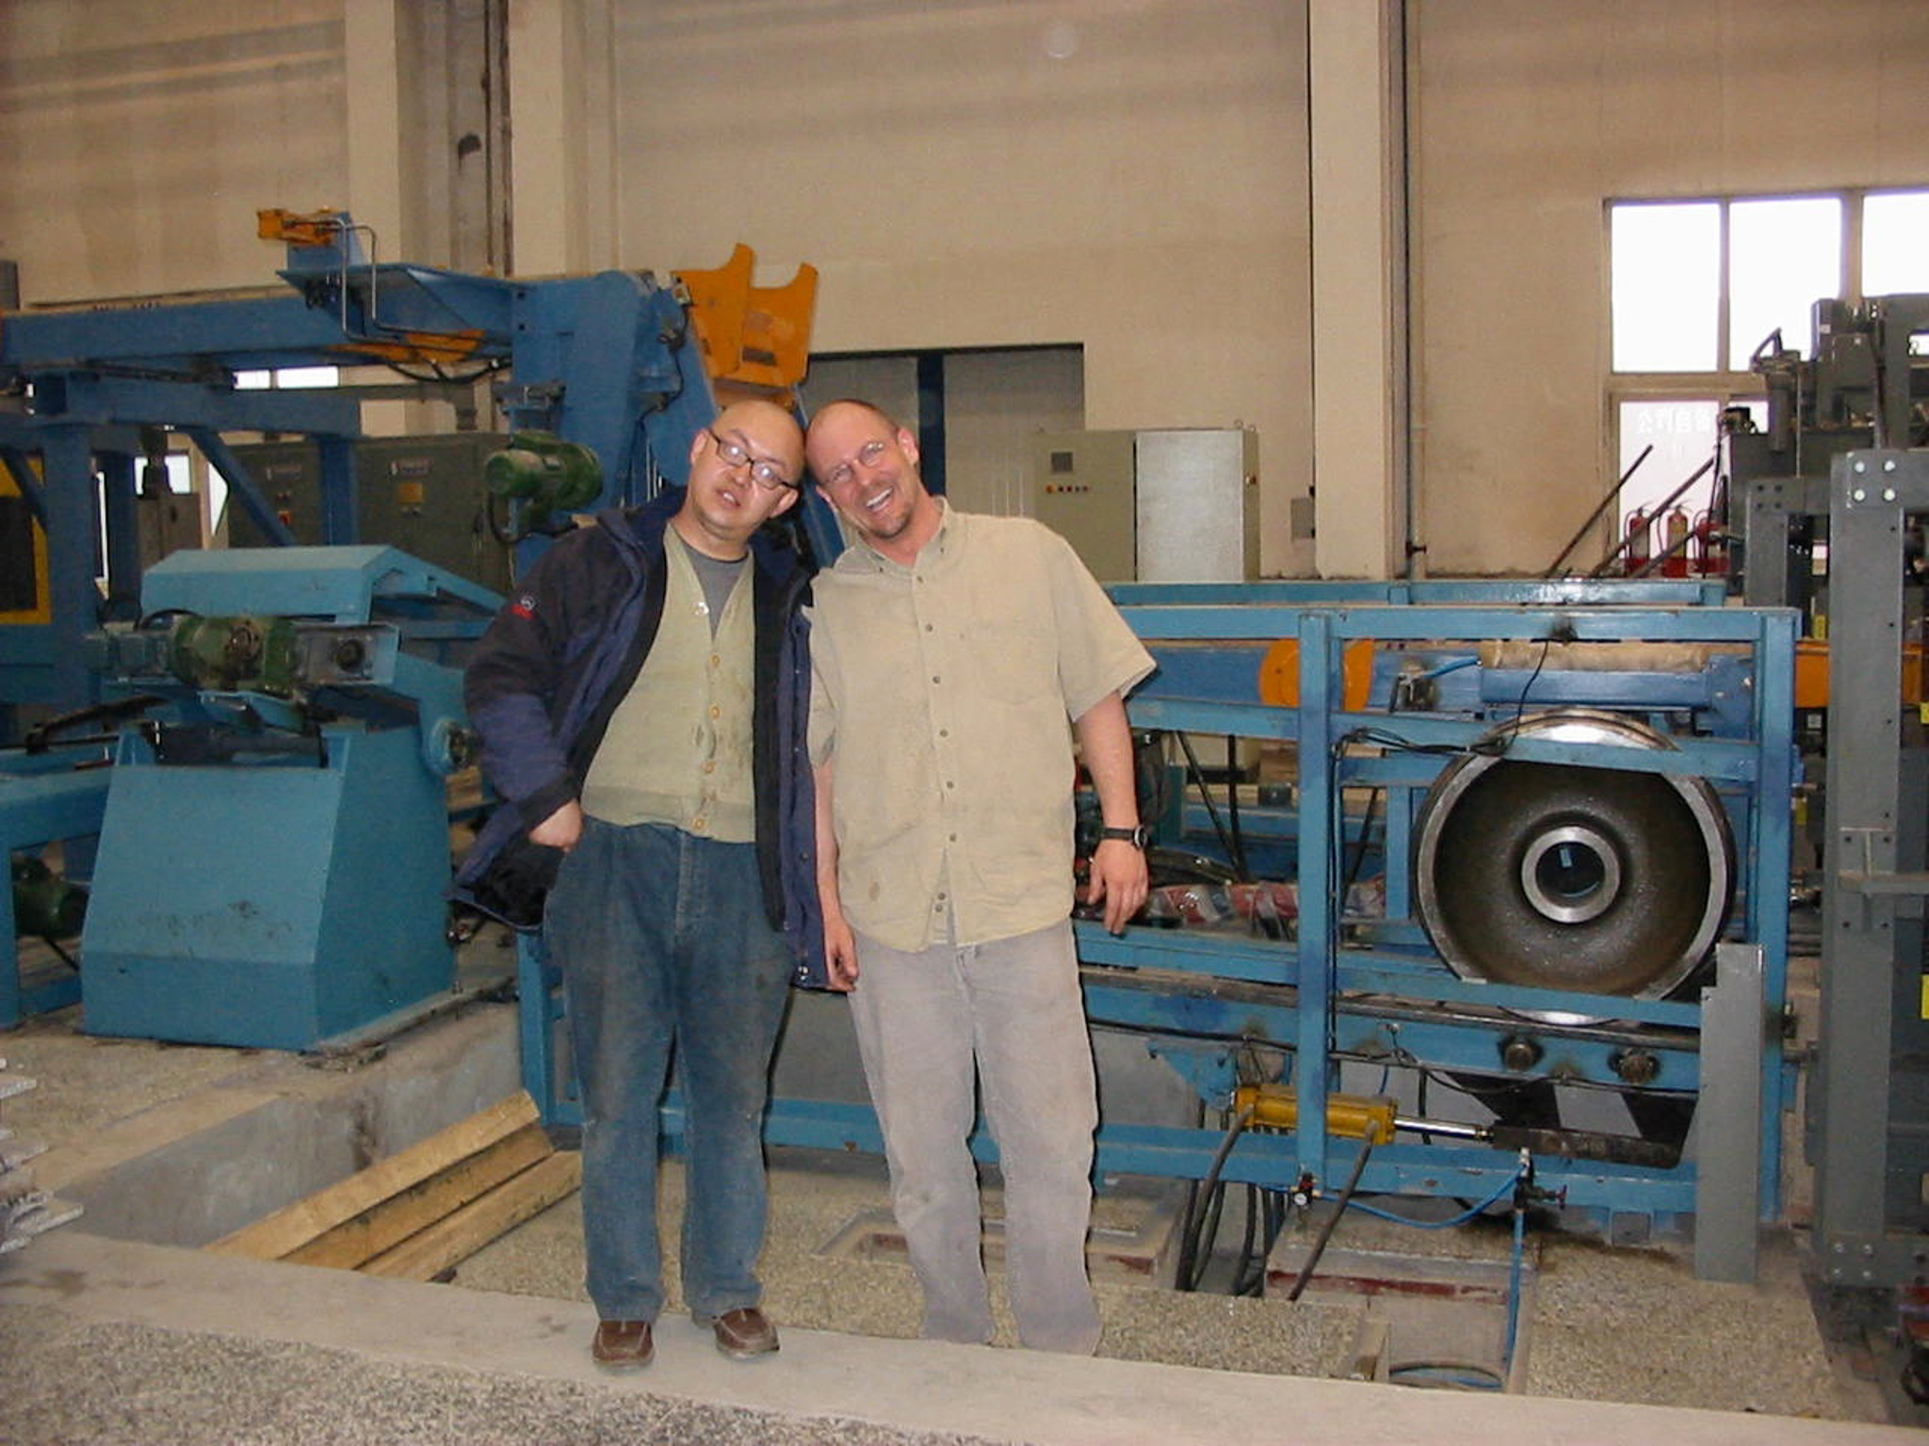
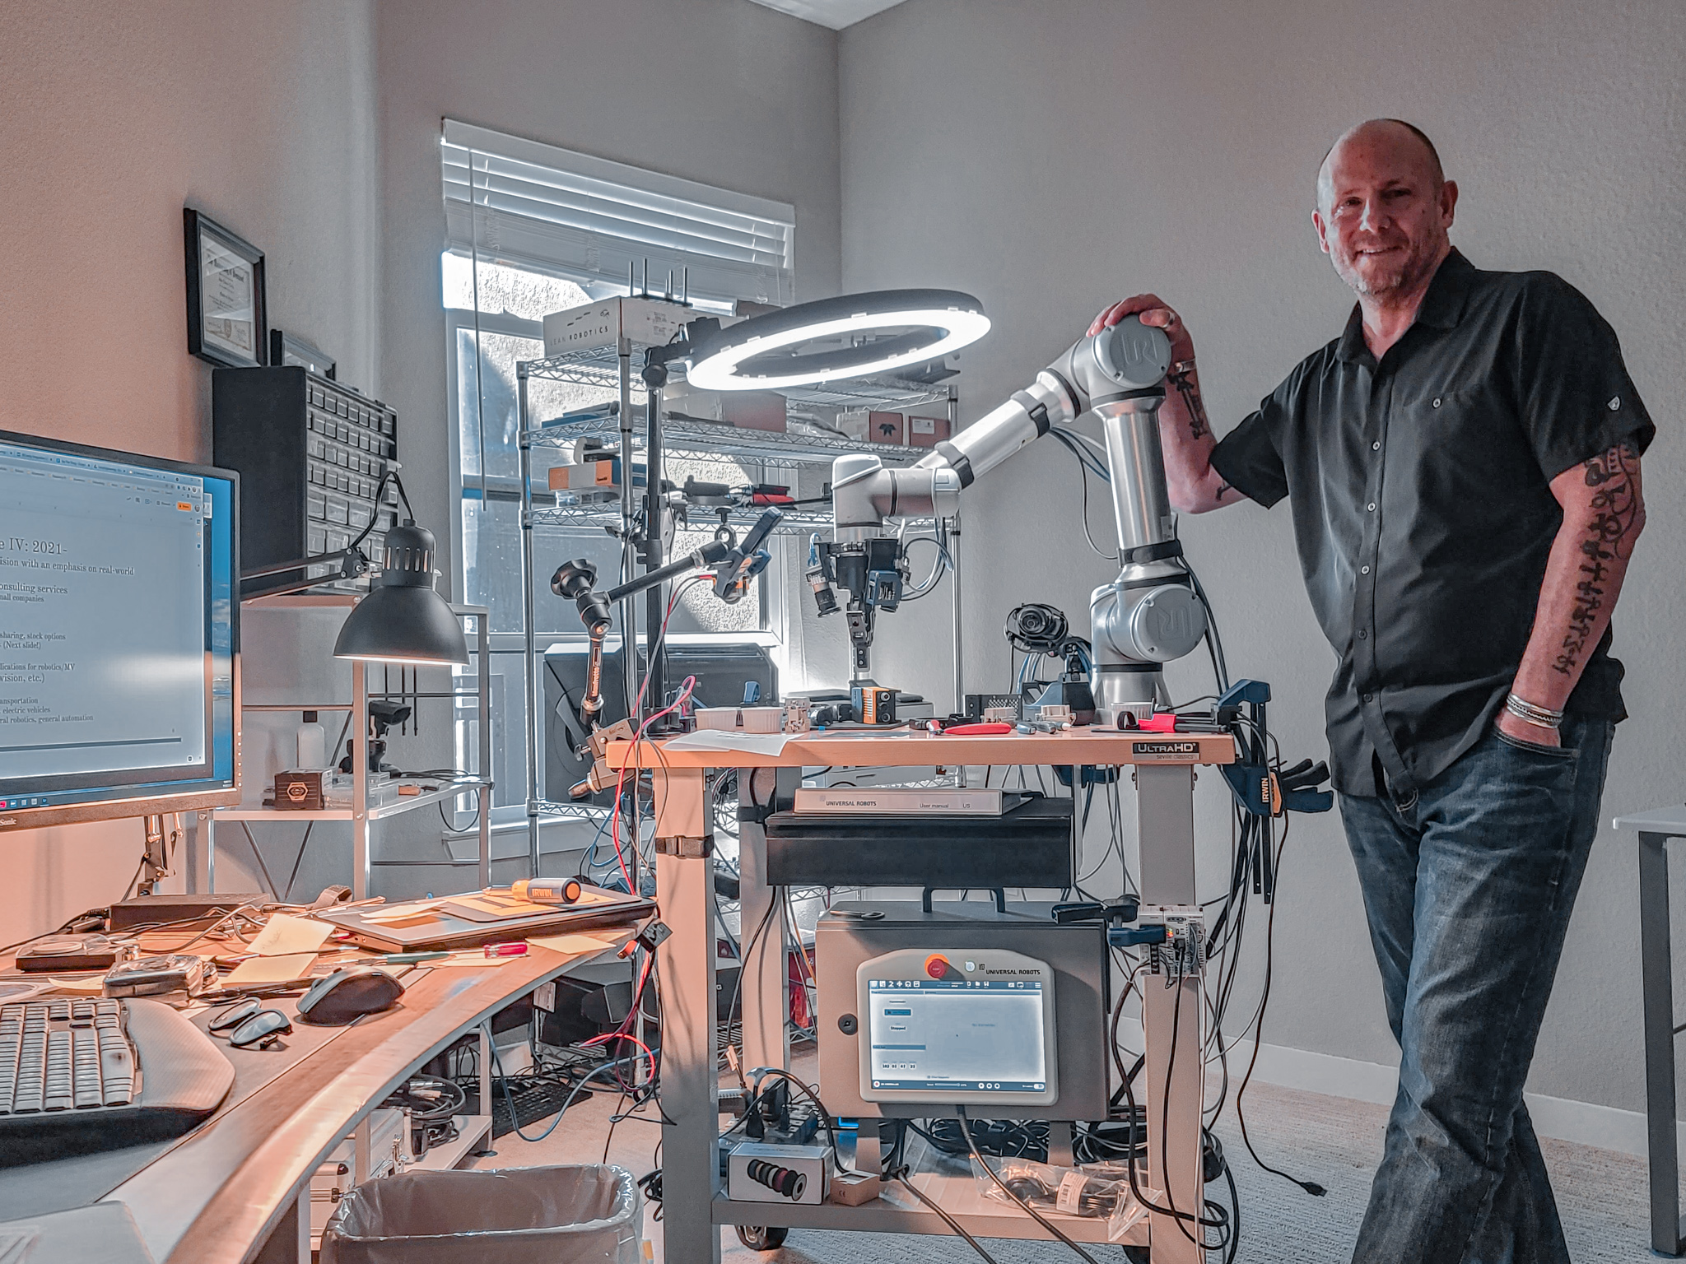
Embedding Artificial Intelligence and Machine Learning in Everyday Applications
For SUNY Plattsburgh
Dr. Ned Lecky
3/22/2023

Slide 2
Abstract
Have you ever wondered if you could use Artificial Intelligence or Machine Learning for real-world, practical applications in science and industry? It may be easier than you think!
I have developed AI and ML solutions and techniques that yield practical results for over 20 years, but still feel that this part of the AI/ML landscape is one of the most neglected in the field. My talk will present several applications I have used as testbeds during my PhD research and in two courses I have developed that employ AI in simple robotic applications, one of which I am teaching this semester at SUNY Plattsburgh

Slide 3
Outline: My Research Journey
1987
PGA Folding: My MS Thesis Work
1994
LeOCR: A simple neural-network based algorithm
1998
Scouting: My PhD work
2001
EE295 (UVM): Intro to Neural Network-based Control of Robotic Manipulators
2009
Sub-pixel Pattern Alignment
2020
Google and DeepMind: Brighton Beach Lab
2023
CSC485B Machine Learning for Robotics

Slide 4
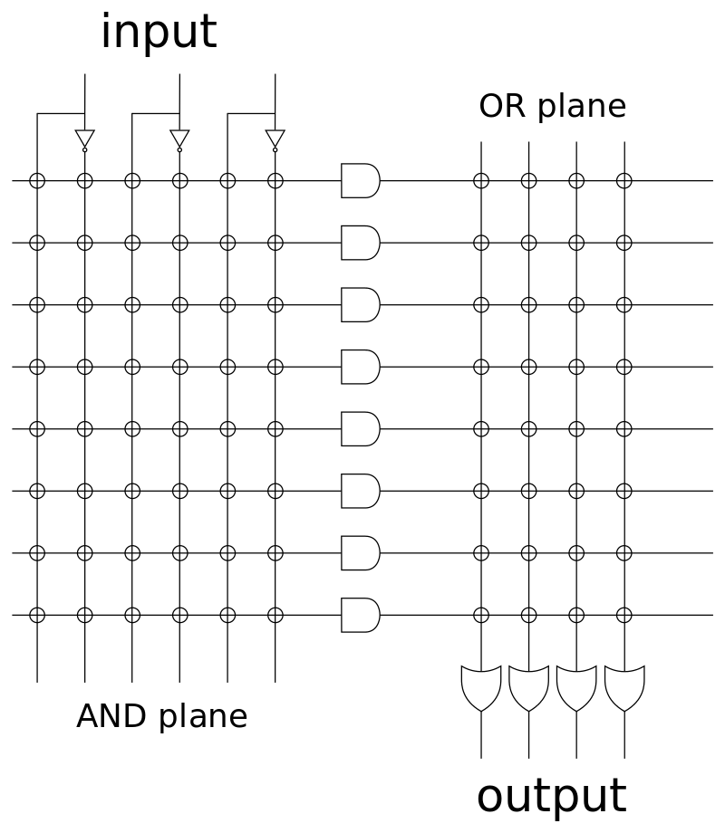
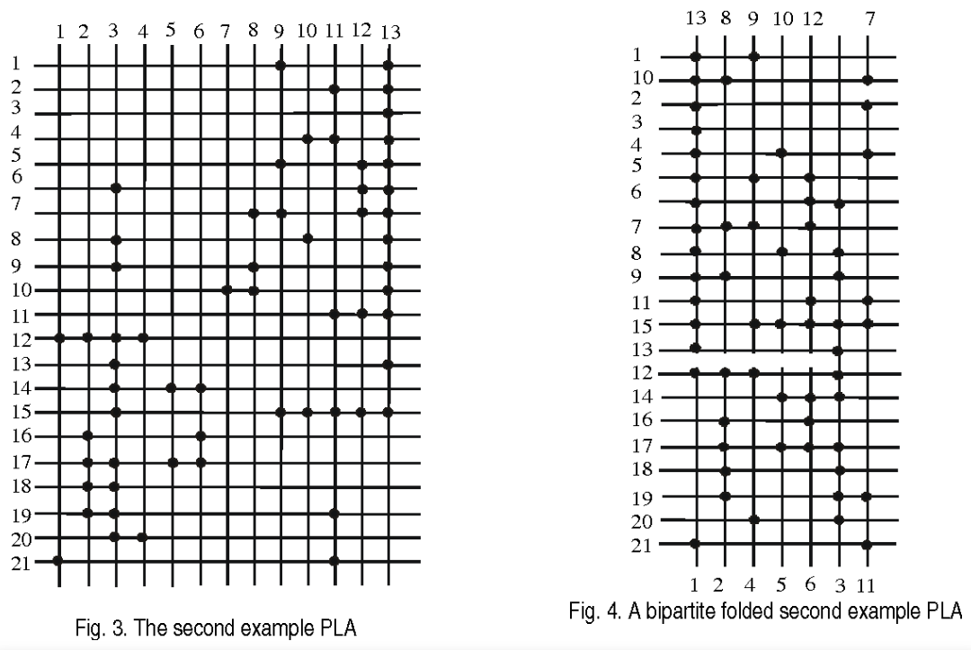
PLA Folding- An AI Problem
This is a hardware area optimization problem in VLSI design
Based on a paper describing the problem in 1985, I developed a graph-theoretic formulation of the problem and a solution methodology
Finding cliques in a graph is a classic NP-complete problem
https://en.wikipedia.org/wiki/Clique_problem
https://www.semanticscholar.org/paper/Graph-theoretic-algorithms-for-the-PLA-folding-Lecky-Murphy/7300bcb4e11c71bf844556eccb7520a63ccec94d

Slide 5
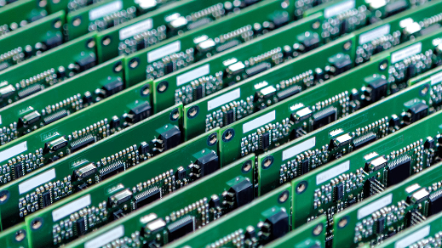
LeOCR
I invented an Optical Character Recognition algorithm that was ML-based but relatively simple
Needed to be able to read >3000 characters/sec on a 1994-vintage PC
Inspecting >10 memory chips/second at Micron Technology
Custom code all personally written in C++ and assembly language
Also upgraded to use early GPUs
Intel MMX (Matrix Math Extension) assembly language
Precursor to several technologies by Intel and others: 3DNow!, Streaming SIMD Extensions (SSE), and ongoing revisions of Advanced Vector Extensions (AVX).
Key Requirements
Print quality is highly variable
Character aspect ratio is highly variable
Character strokes are inconsistent and frequently broken

Slide 6
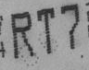
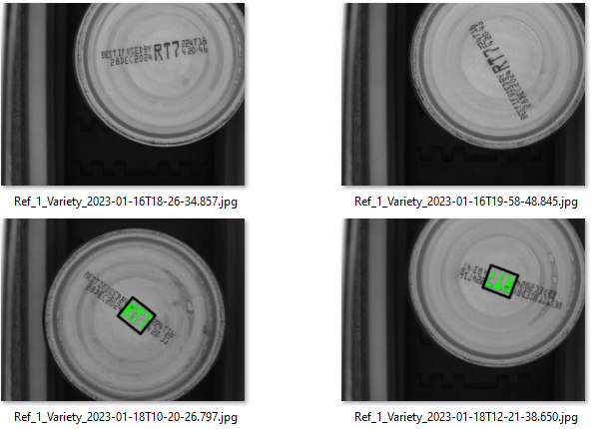
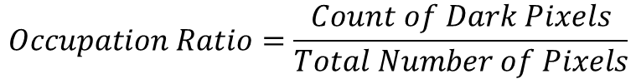
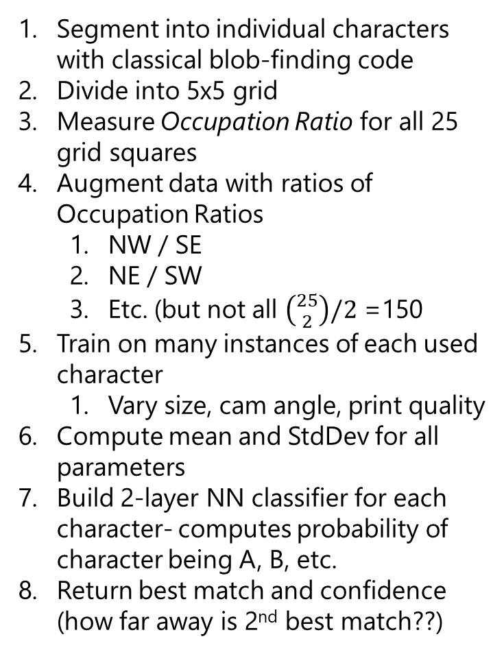
How did it work?
$$Occupation Ratio=\frac{Count of Dark Pixels}{Total Number of Pixels}$$
Segment into individual characters with classical blob-finding code
Divide into 5x5 grid
Measure Occupation Ratio for all 25 grid squares
Augment data with ratios of Occupation Ratios
NW / SE
NE / SW
Etc. (but not all $\left({25 \atop 2}\right)/2$ =150
Train on many instances of each used character
Vary size, cam angle, print quality
Compute mean and StdDev for all parameters
Build 2-layer NN classifier for each character- computes probability of character being A, B, etc.
Return best match and confidence (how far away is 2nd best match??)

Slide 7
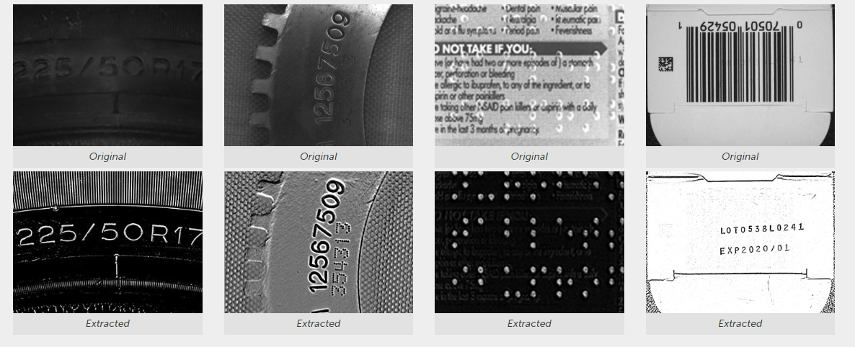
Eureka!
This turns out to be a hard-coded and heavily code-optimized version of a very application-specific neural network
The code was built into the Sherlock product that I developed in the 1990s
Sold to Imaging Technology (now Teledyne DALSA in 1995)
Still sold today: website
Library was licensed to Micron Technology and was their only way of reading memory chip IDs in manufacturing for over a decade

Slide 8


Slide 9
PhD Dissertation, 1995-1999
A Cognitive Computing Architecture, 1999 (UVM)
LeOCR makes calculations
What if you want to make decisions?
Developed a hardware-based FPGA implementation of specialized Monte Carlo approaches
Could run many instances in parallel
Many problems addressed
Scouting
Introduced the Scout
Next: Some slides from my Dissertation Proposal
C:\Users\nedlecky\Desktop\Interview\ScoutingPhD\PhD\Dissertation\The Book

Slide 10
So How Do Animals Think?
Dissertation Proposal, 1999
A Fly
1 million neurons
A chimpanzee
25 billion neurons
A human
100 billion neurons
the first 20 billion must be uninteresting
And never blows a landing!
2023:
Better phrase- doesn’t get you to human-like intelligence

Slide 11
Brain Architecture
Dissertation Proposal, 1999
Direction of evolution
Where all those extra neurons are growing!

Slide 12
The Neocortex
Dissertation Proposal, 1999
Why is it so BIG in humans?

Slide 13
Neural Macrocolumns
Dissertation Proposal, 1999
Controversial organization of the neocortex, but evidence is compelling
Architecture is cylindrical “modules” of 100-2000 neurons, 0.5 mm in diameter, extending through all 6 cortical layers
These modules are VERY LOOSELY homogeneous; humans have ~1,000,000
A theory to motivate my research!

Slide 14
What Might These Modules Do?
Dissertation Proposal, 1999
Note: PRIOR to initiation of motion, great activity is observed in the motor cortex
This is believed to be planning
This (or any) planning could be many simultaneous simulations of the motion, waiting for one simulation to “succeed”

Slide 15
Digital Macrocolumn: Scout
Dissertation Proposal, 1999
A “scout” processor makes random forward moves until it hits the goal or is reset
It has limited ability to avoid backtracking
Advantages
no coordination overhead
simple design can be built in HARDWARE
Generalized parallel Monte Carlo coordinated in hardware

Slide 16
Scout Block Diagram
Dissertation Proposal, 1999

Slide 17

Results
Scouting looked very promising for solving decision problems that had no obvious strategy or algorithm
The concept has been used by many others to solve decision problems
It is simple and straightforward to code, and many times a software simulation of this parallel hardware approach is good enough for solving real-world problems
Uses: I built a system for BioTek Instruments in Winooski VT that was based on the idea for scheduling robotic handling of blood samples
No idea if they kept the idea or scrubbed it, but Agilent bought them in 2019 for >$1B (NOT that I helped!!!)
More code: https://github.com/nedlecky/Scouting

Slide 18
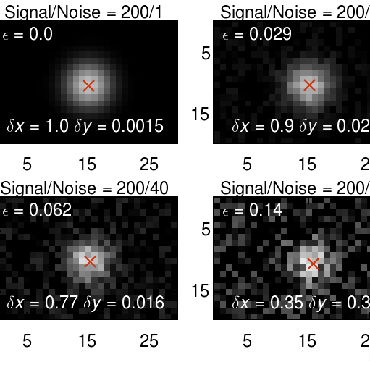
Pattern Alignment Techniques
If your pattern is misaligned by some fractions of pixels, can you estimate what the fraction is?
Problem is very important in semiconductor wafer alignment and many manufacturing and robotics applications
Can we estimate actual centroid when we are off by some fraction of a pixel and subject to noise
Developed many techniques both computational and ML/training-based
Code incorporated in several products sold in Machine Vision marketplace

Slide 19
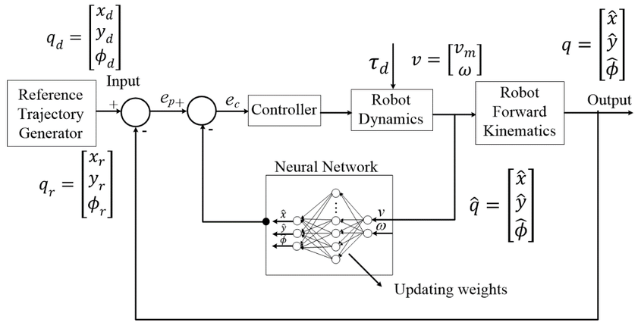
Neural Network Based Control
I developed and taught EE295 (UVM) in 2001
Neural network applications were getting a second look in the 1990s
Learned a crucial concept
Use the “AI” for as small a problem as possible

Slide 20
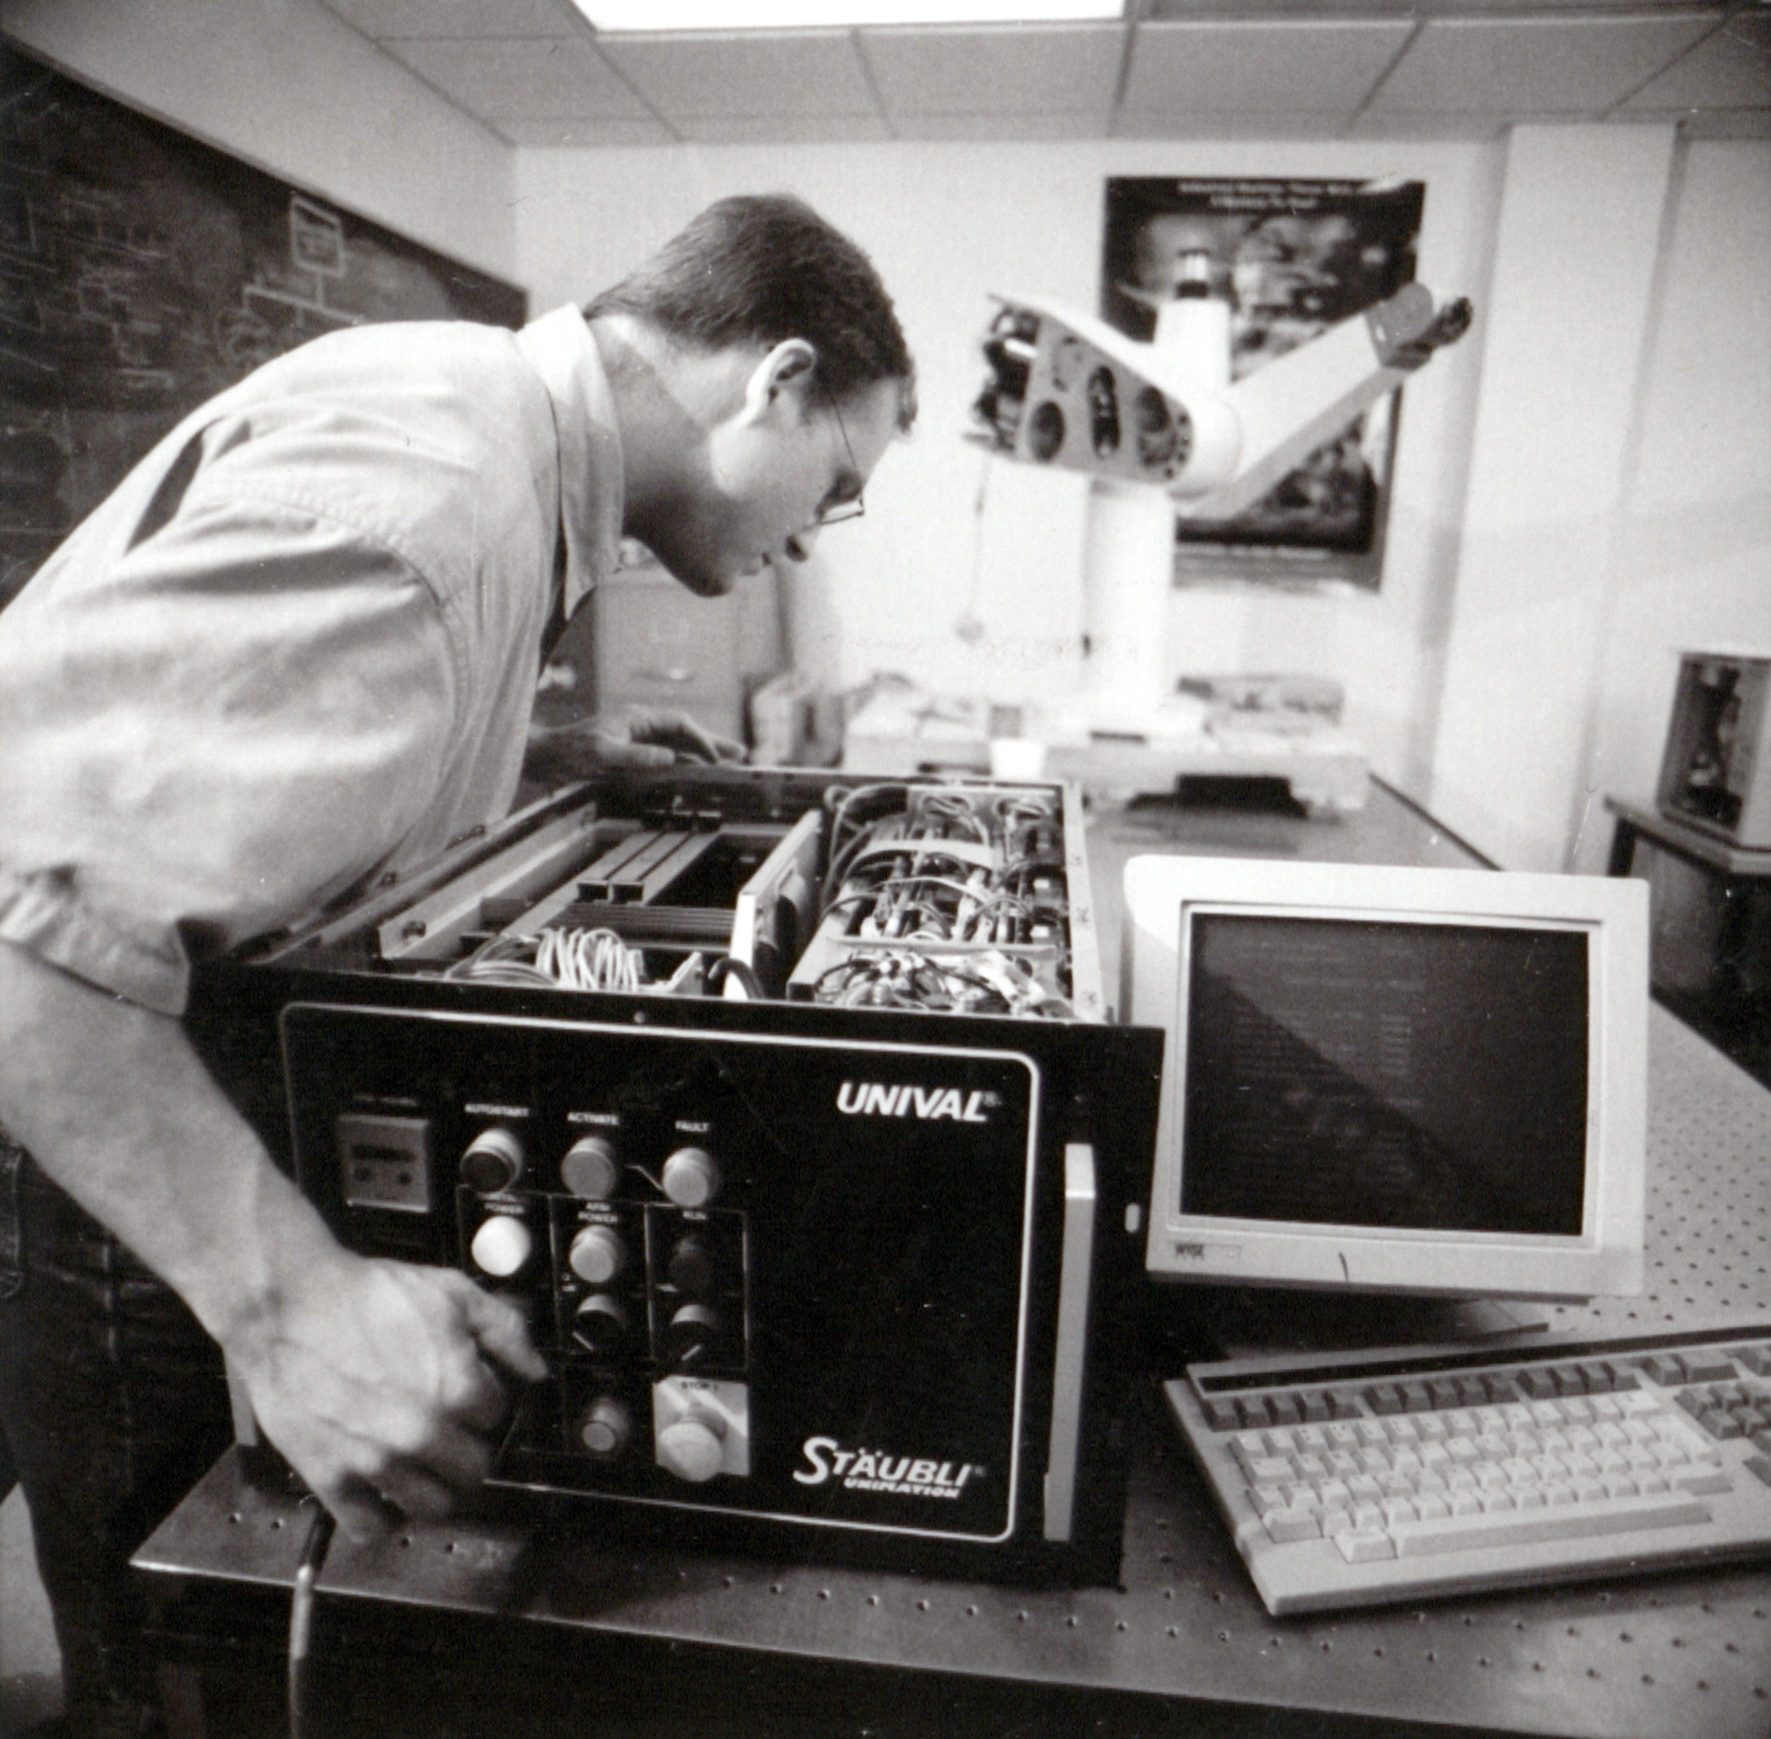
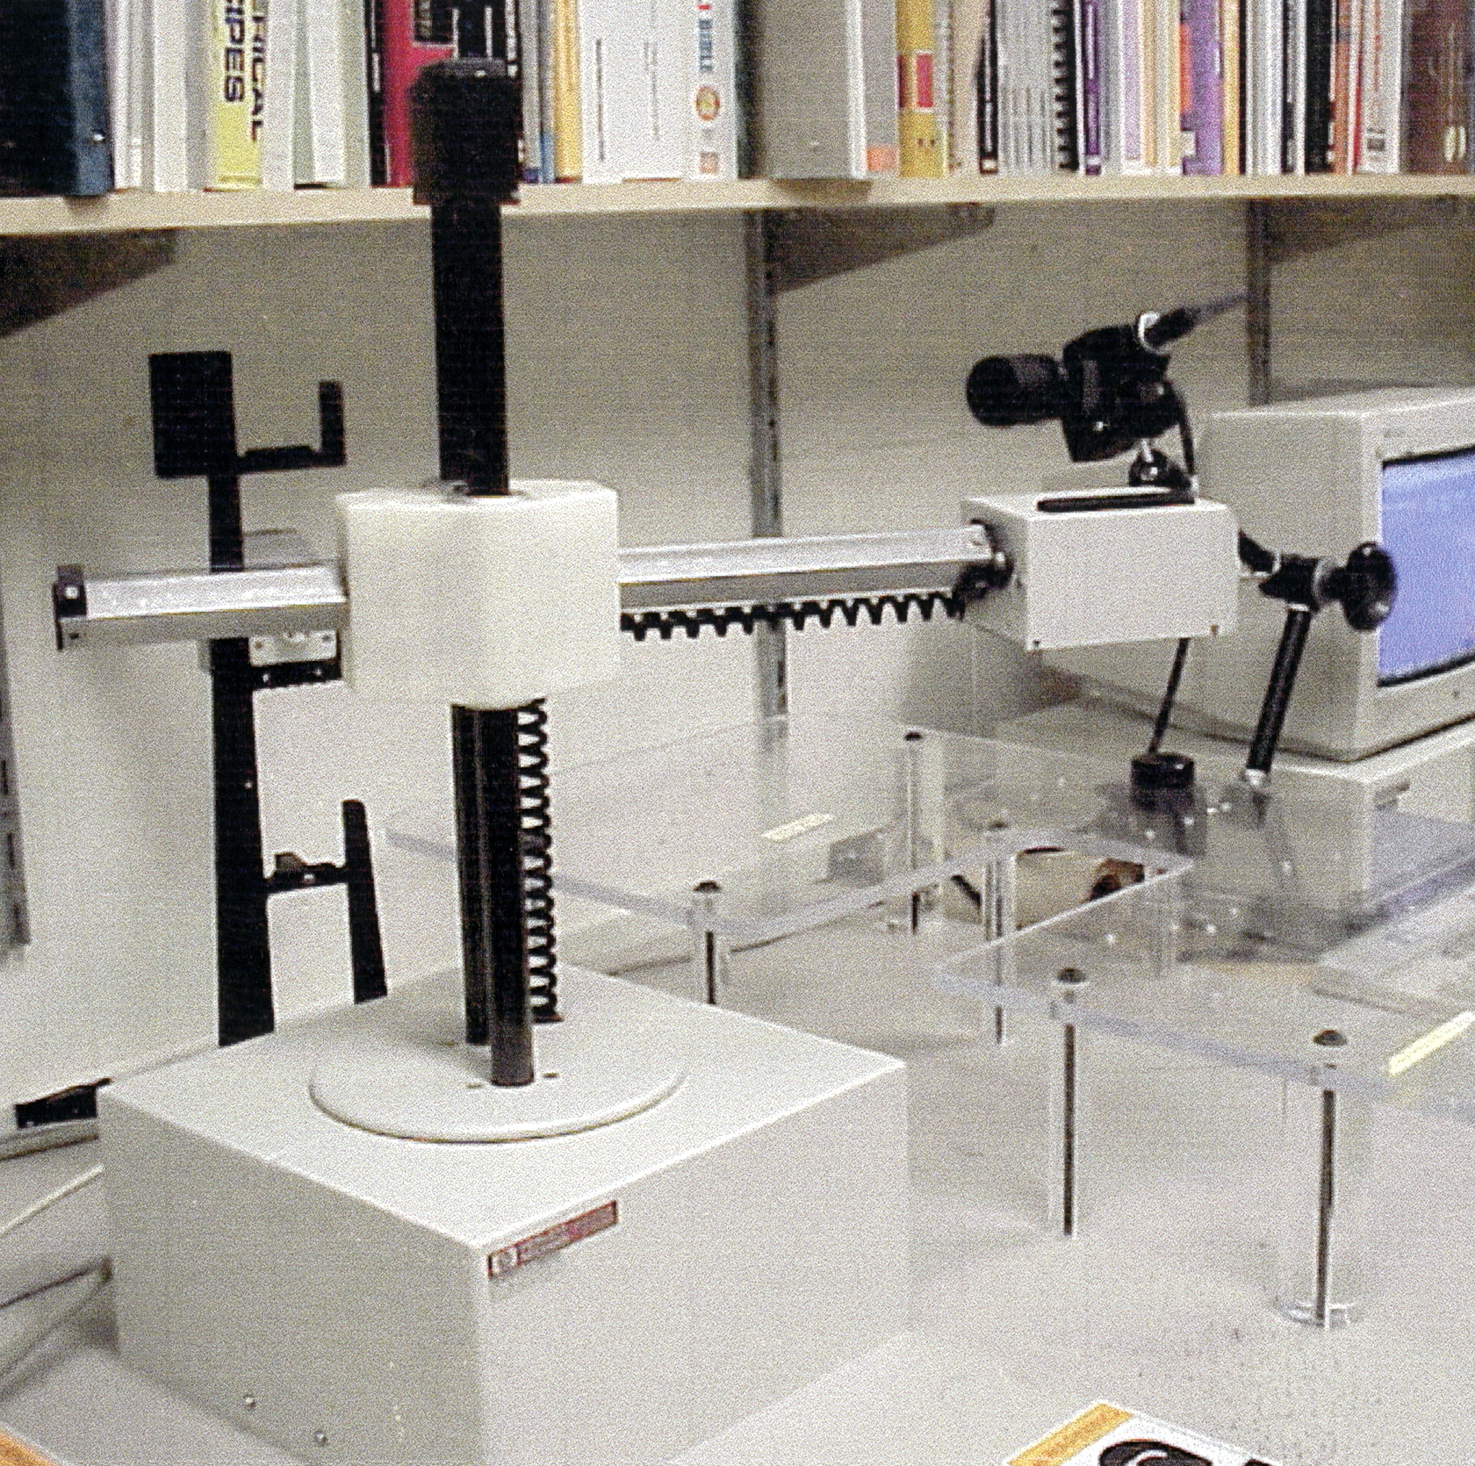
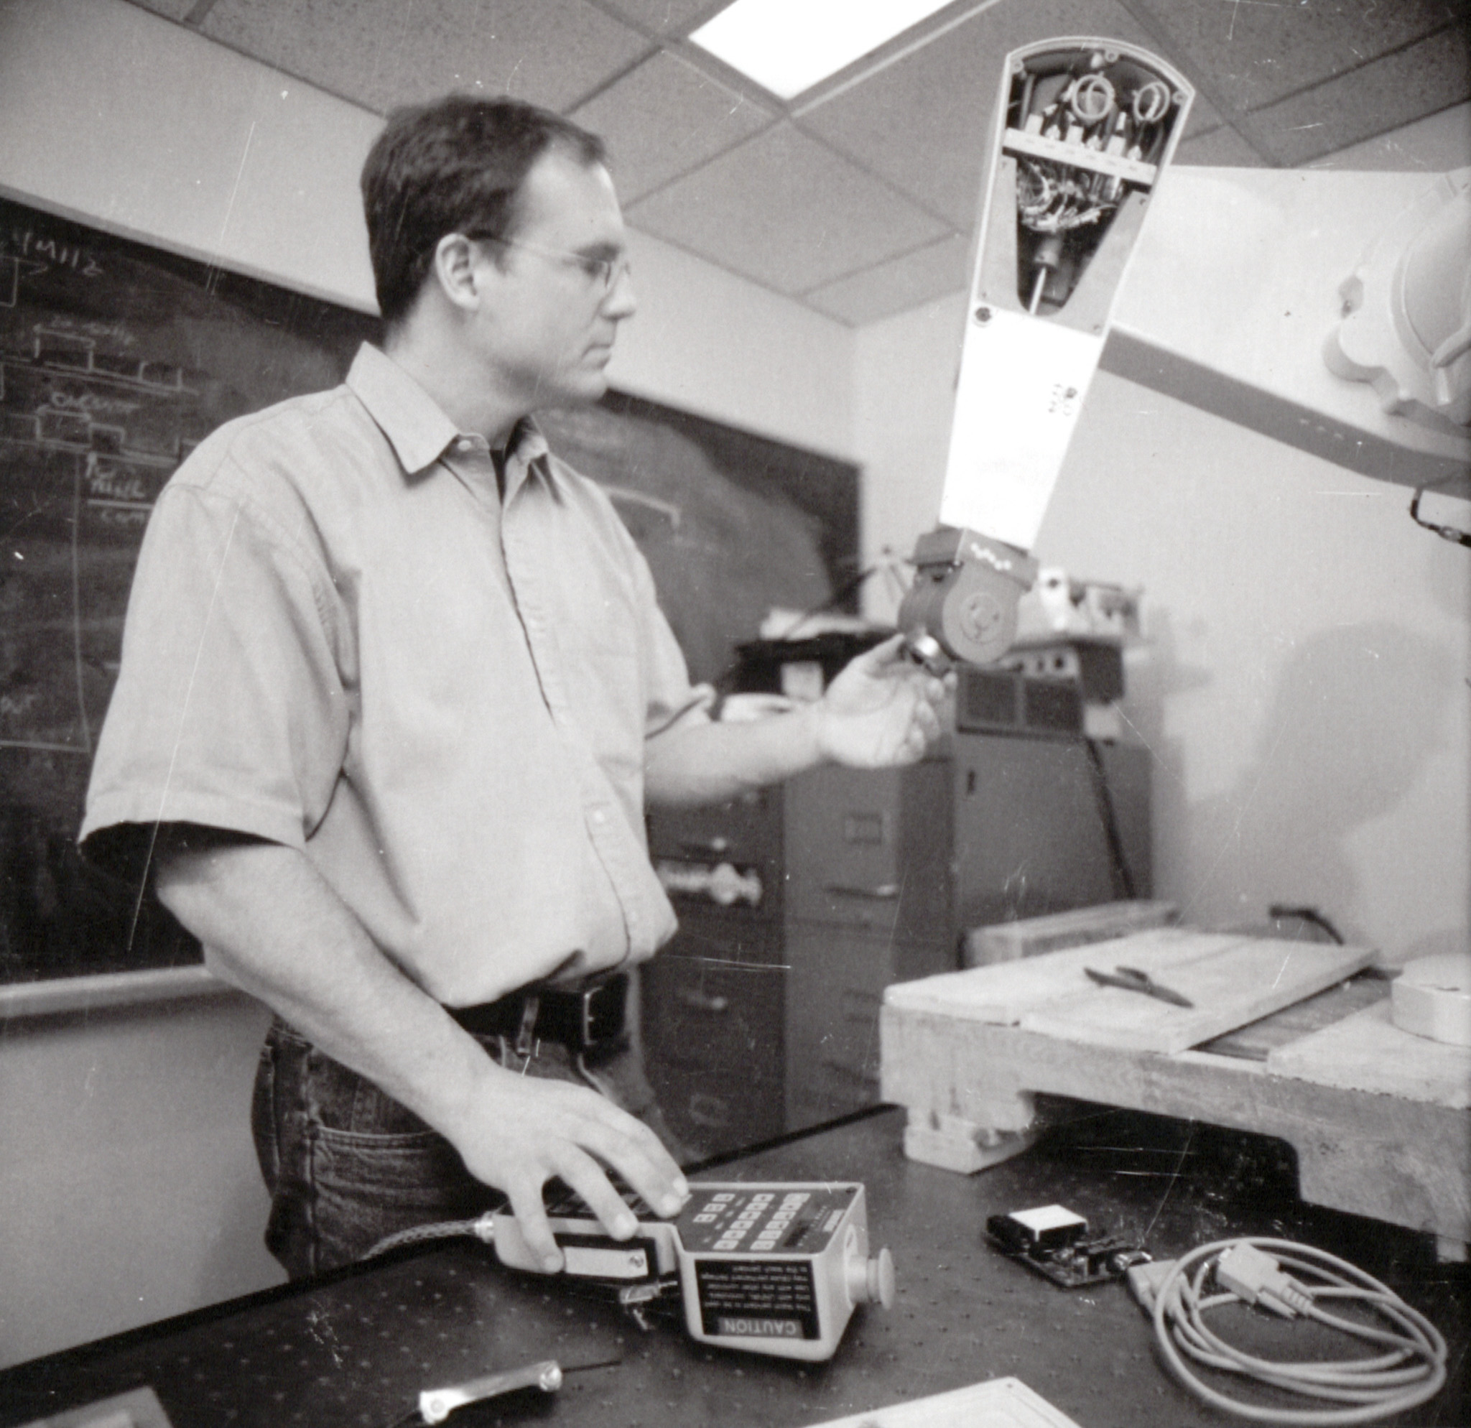
EE295: Neural Control for Robotics, 1999
Built our own Neural Networks in C++
Built a library to handle matrix math and neural network operators in C++
C:\Users\nedlecky\Desktop\Interview\EE295Code

Slide 21
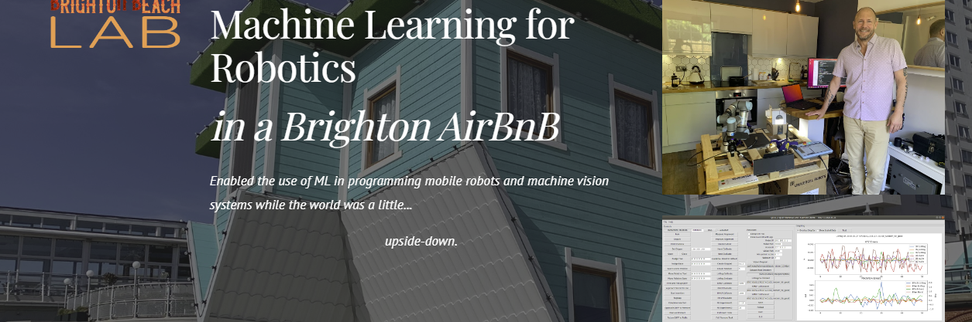
Brighton Beach Lab?
I was on loan to Google DeepMind from February to June of 2020
The problem: “Teaching” robots to plug network cables into servers
Brighton Beach Lab walk-through
https://sites.google.com/lecky.com/brighton-beach-lab/home

Slide 22
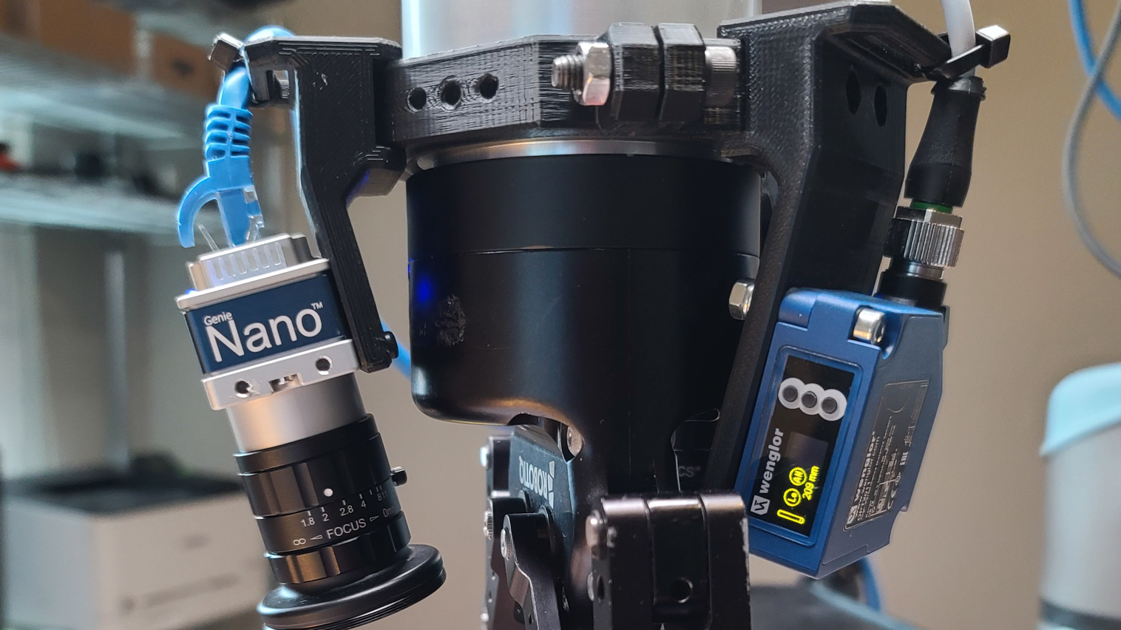
Fast Forward to Today
CSC485B Machine Learning in Robotics Applications
https://github.com/nedlecky/CSC485B
Bringing students along from using a neural network to convert from Celsius to Fahrenheit! ☺
Then converting non-linear thermocouple voltages to temperature
And solving simple but more non-linear problems like Pythagoras
Regression is useful
Classification and clustering are very powerful today as well

Slide 23
The Take-Away Lesson?
Regression, Classification, Clustering
They only work if we make sure our problem can be forced into simple math

Slide 24
What’s Next?
The combination of Scouting Ideas and ML (also broader “AI” kinds of techniques) is very interesting and can be useful
Many core libraries exist to help today, but they rarely solve the problem at speed or with enough accuracy, so custom algorithms and hybrid approaches have great value
AI and Computer Vision have always over-promised and under-delivered
BUT: a cautious, practical, and clever approach can ACTUALLY WORK on many real, practical problems
That’s my research interest

Slide 25
Thank You!
Comments?
Questions?

